Slide 1
Machine Learning Project:
Intrusion Detection Systems (IDS)

Slide 2


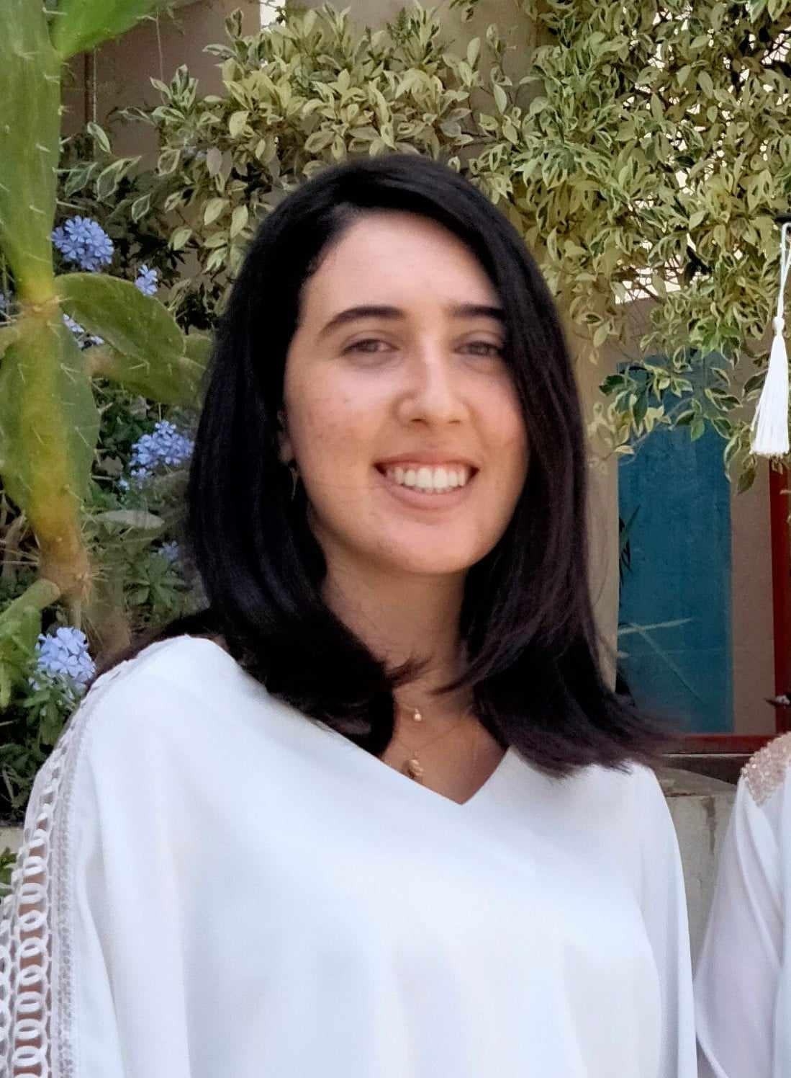




Members of the groupe
Maram Brinsi
Mohamed Hachicha
Ameni Belhadj
Mohamed Ghassene Hanchi
Ali Khemakhem
Tarak Jaziri
Amira Khalfi

Slide 3
Summary
Business Understanding
01
02
Data Understanding
03
Data Preparation
Modeling
04
Evaluation
05
Deployment
06

Slide 4
Business
Understanding

Slide 5


What is an intrusion ?
An intrusion refers to any unauthorized access, entry, or activity in a computer system, network, or application. Intrusions are typically carried out with malicious intent, and they can take various forms,Intrusions are caused by attackers accessing the systems from the Internet, authorized users of the systems who attempt to gain additional privileges for which they are not authorized such as:
Denial of Service (DoS) Attacks
Malware Infections
Unauthorized Access

Slide 6
Types of intrusion
Denial of Service (DoS)
Types of intrusion
Probe Attacks
U2R(User to Root)
U2L(Remote to Local):

Slide 7

What is an IDS
It is software that checks a network or system for malicious activities or policy violations. Each illegal activity or violation is often recorded either centrally using a SIEM system or notified to an administration

Slide 8
Business Objectives
01
02
Supervised learning
Unsupervised learning
Anomaly Detection
Network Flow Classification
(Binary / multiclass classification)

Slide 9
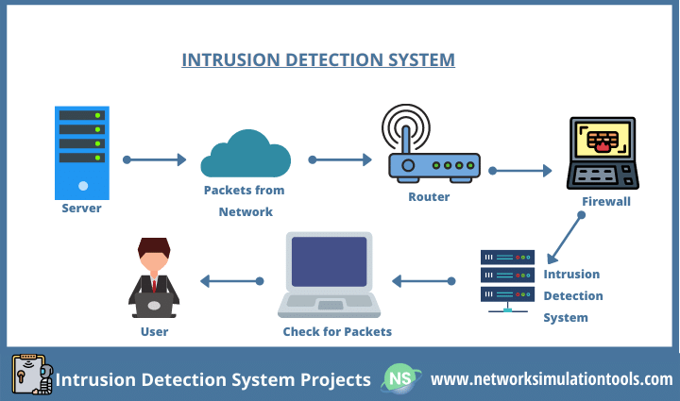
How does an IDS work?

Slide 10
2) Data
Understanding

Slide 11

DataSet OverView
Why Not KDD'99?
Why NSL-KDD Dataset:
Vs
The dataset has lots of duplicate records, which could make the model miss rare but important network intrusions.
NSL-KDD is a useful dataset for comparing intrusion detection methods, offering reasonable record sizes for consistent and comparable evaluation results

Slide 12
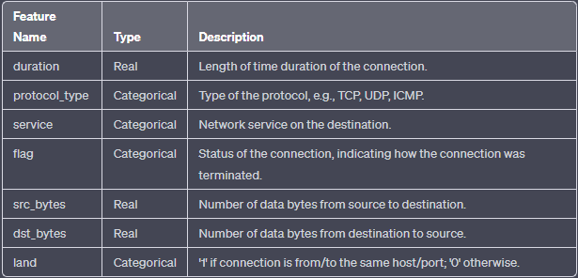
Feature Identification and Categorization
Connection Information

Slide 13
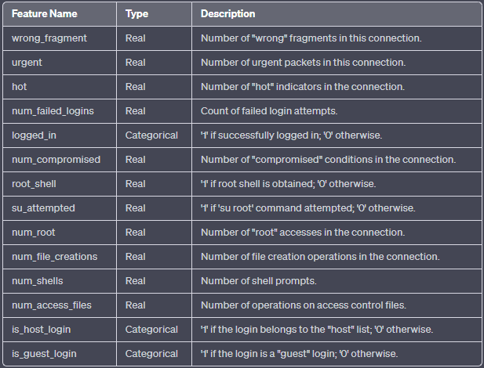
Feature Identification and Categorization
2) Connection Content

Slide 14
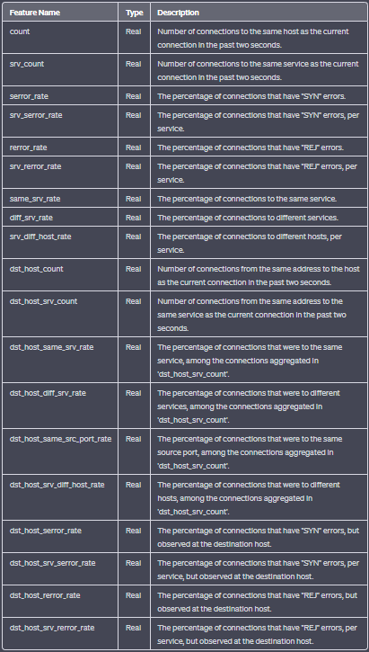
3) Traffic Information :

Slide 15
Two Approaches
01
Paper 1 :
supervised learning
02
Paper 2 :
Unsupervised learning

Slide 16

a)PAPER 1 :
Supervised learning

Slide 17
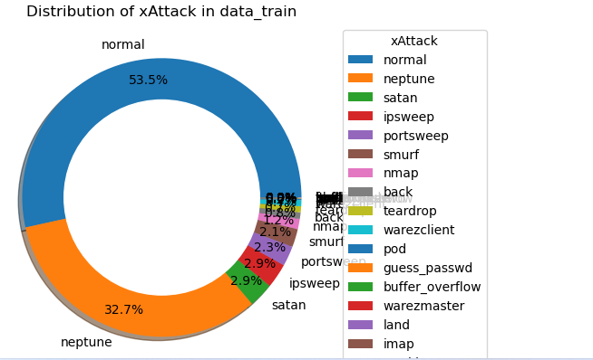
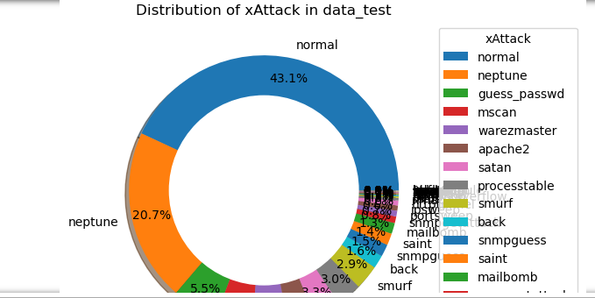
Distribution of the dataset

Slide 18
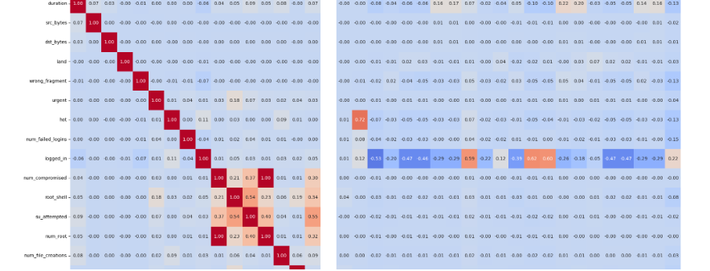
Exploratory data analysis :
A) Relationships

Slide 19
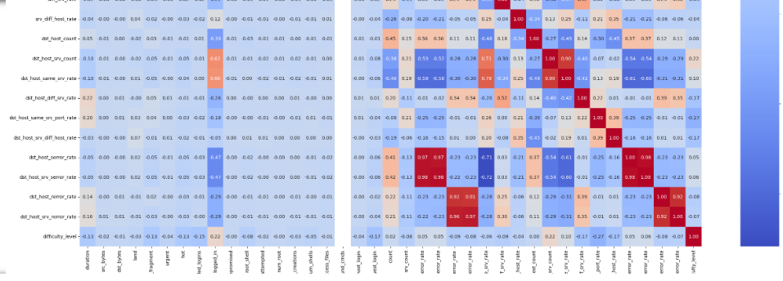
as we can see , num_cmd_bound has no correlation with any feature so we have to drop it in the data preparation

Slide 20
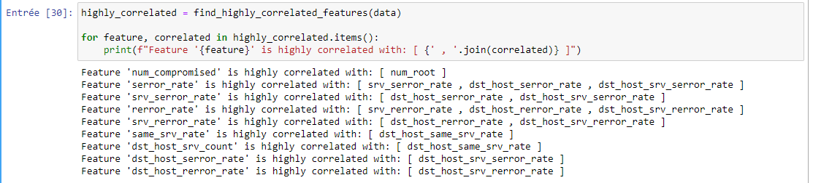
we have to drop features in the data preparation which are highly correlated to eliminate redundancy

Slide 21

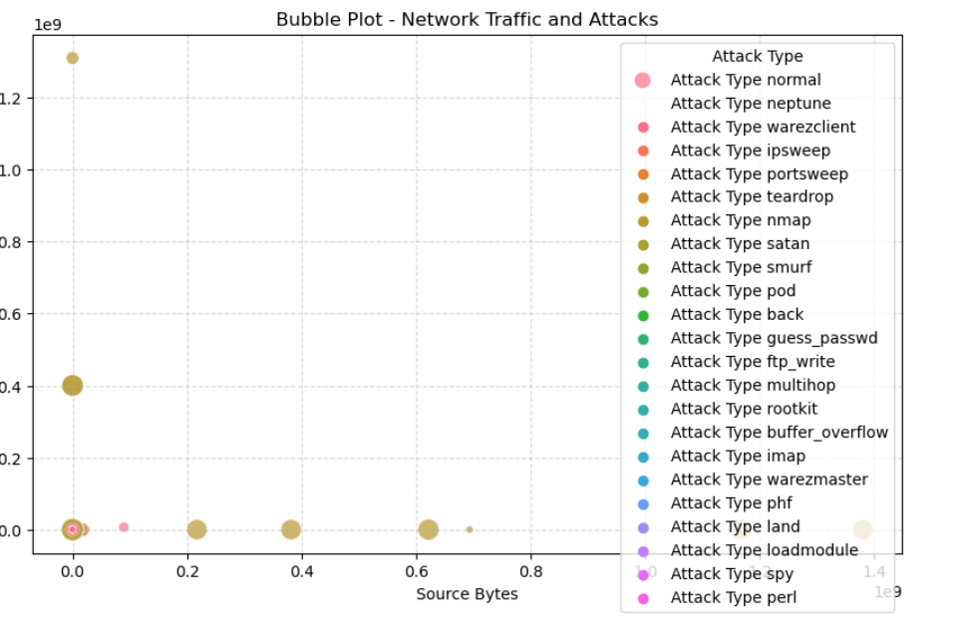
Bubble Plot
Exploratory data analysis :
B) Distribution

Slide 22
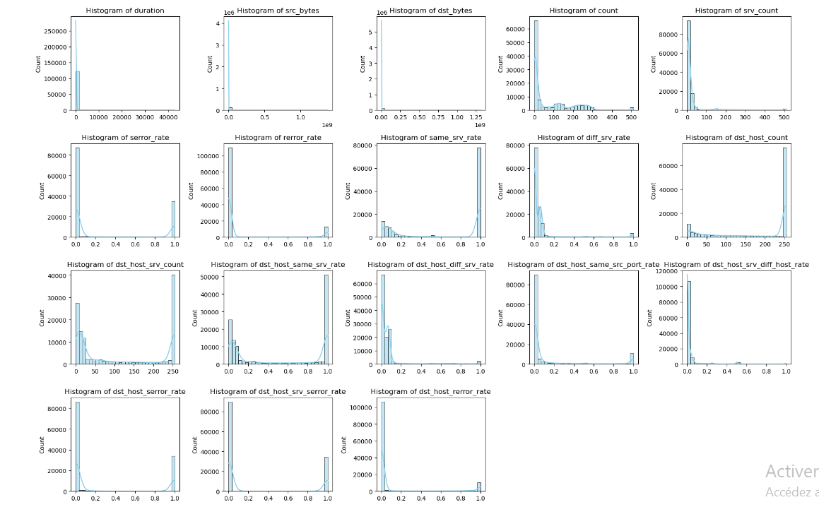
HISTOGRAMS

Slide 23
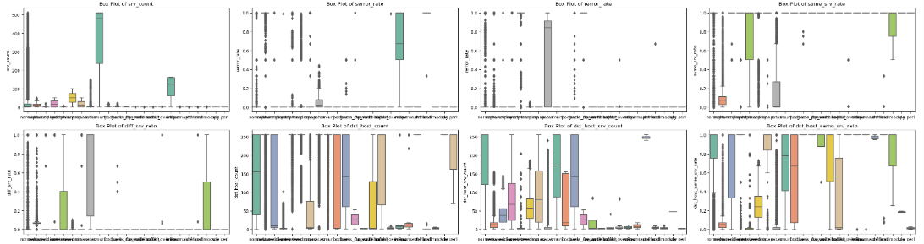
Exploratory data analysis :
C) Compositions :

Slide 24
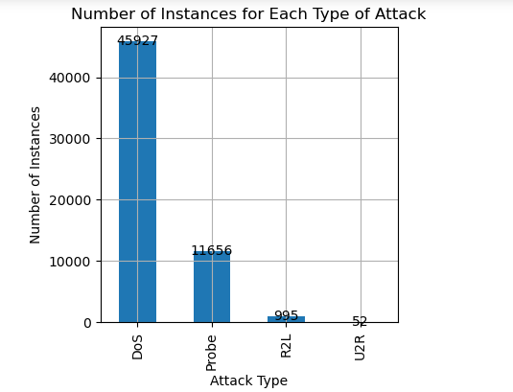
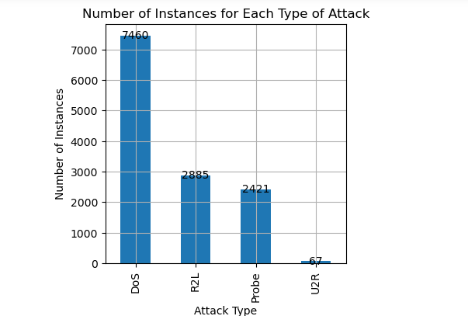
Fig 1. shows the number of instances of each attack type in the train dataset while Fig 2. presents data from test
dataset. The analysis shows that DoS class has maximum instances in both datasets.

Slide 25


OUTPUT (1)
Normal Traffic
Attack

Slide 26
3) DATA PREPARATION

Slide 27
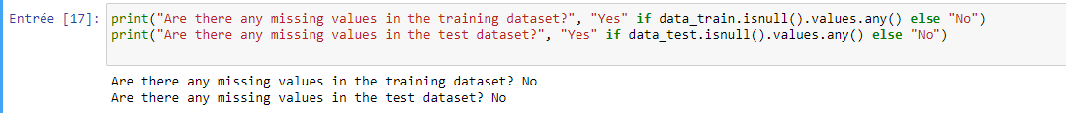
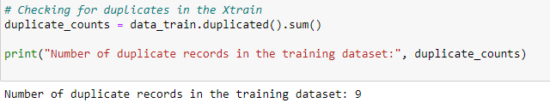
III.1. Data PRE-PROCESSING:
1)Checking for NAN values :
Dropping the duplicates in both data_train and data_test
as we said before in the data visualizing , we're going to drop correlated features
2) Checking for duplicates :

Slide 28

Box Plot
3) Outliers :

Slide 29
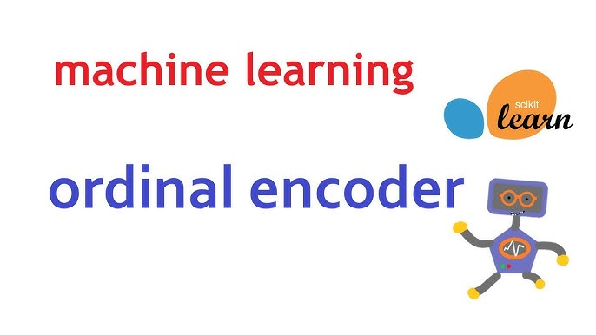
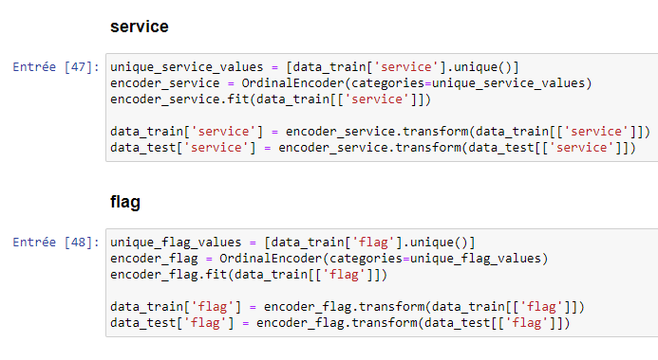

4) Encoding¶

Slide 30
5) Creating SubClasses From data_train and data_test For weather there is an attack or not and for each Attack Type :
01
02
Dos
U2L
Dataset
03
04
Probe
U2R
05
Normal

Slide 31
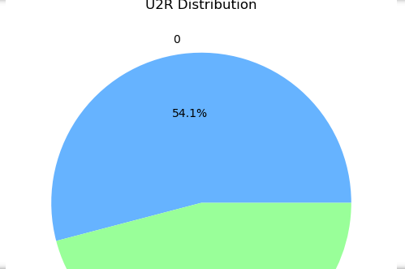
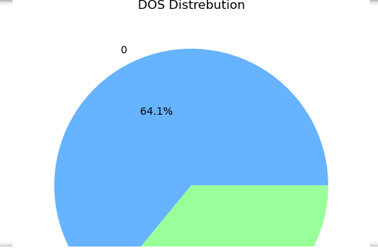
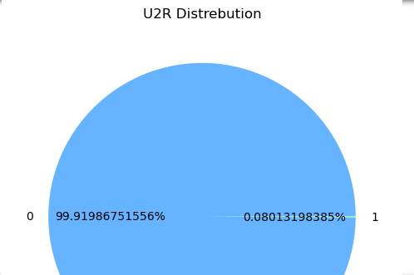
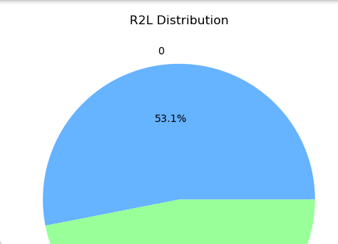
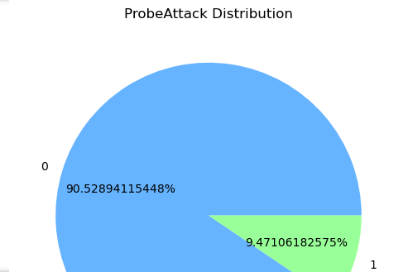
6)Oversampling :

Slide 32

7) Features selection :
02
03
04
Normal
Probe
Dos
Logged_in,
Serror_rate,
Same_srv_rate
dst_host_srv_count
protocol_type, logged_in, dst_host_diff_srv_rate
serror_rate, same_srv_rate, dst_host_srv_count
05
06
U2L
U2R
logged_in, count, same_srv_rate
U2Rroot_shell, dst_host_count, dst_host_srv_count

Slide 33
4)Modeling

Slide 34
For each DataSet we applied these models
Models
Decision trees
Random Forest
KNN
Logistic regression
Support-Vector-Machine
Voting Classifier

Slide 35
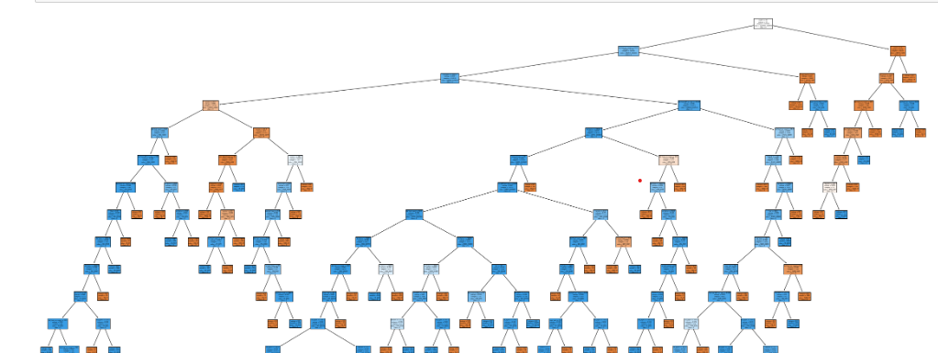
06

Slide 36
5)Evaluation

Slide 37
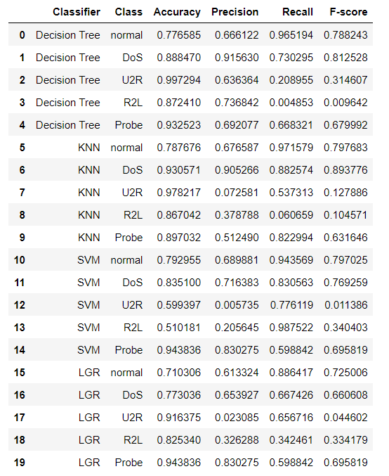
Experimental Result
shows the result of the implementation of each
algorithm
:
Decision tree
KNN
SVM
Logistic regression
of Accuracy, Precision,
Recall and F-score for each kind of attack.

Slide 38
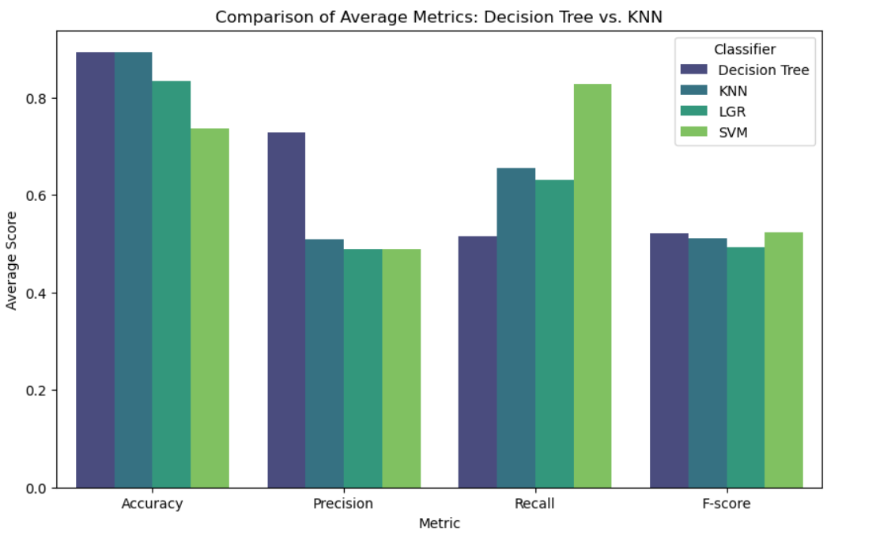
Experimental Result
compares the accuracy of the algorithm for all types of attacks.

Slide 39
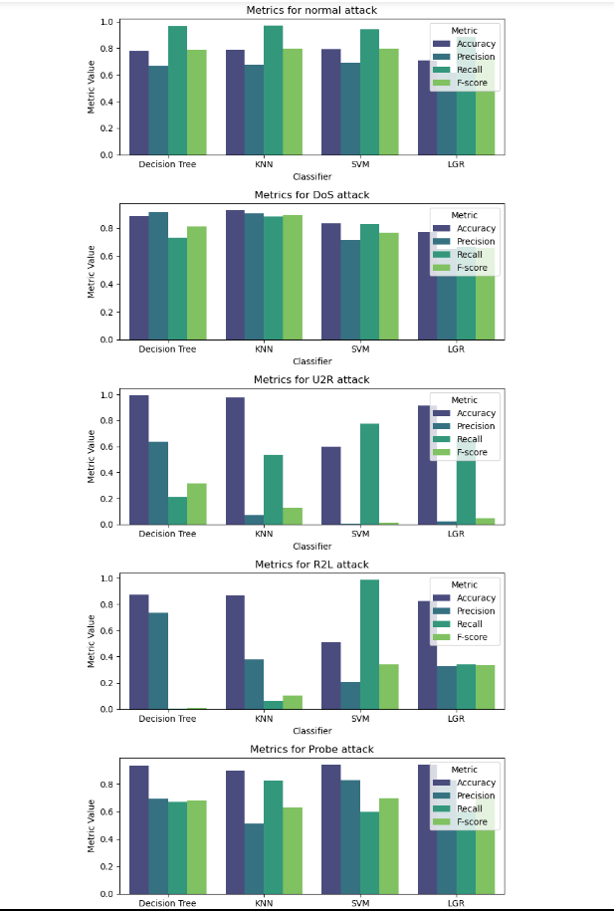
Experimental Result
Comparison of accuracy, precision, recall and
f-score of the all algorithms: Decision tree
KNN
SVM
LGR

Slide 40
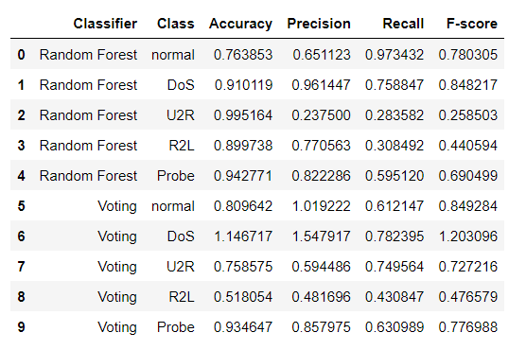
Experimental Result
shows the result of the implementation of both
algorithm
:
Voting Classifier
VS
Random Forest
Accuracy, Precision,
Recall and F-score for each kind of attack.

Slide 41
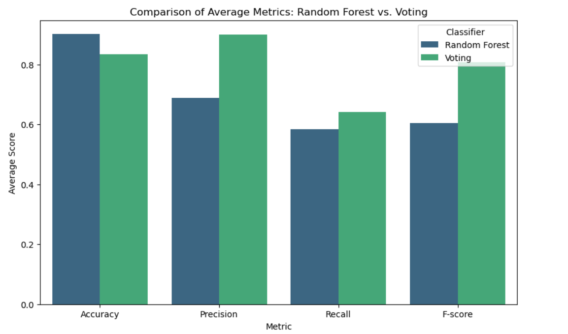
Experimental Result
compares the Average metrics of the algorithms for all types of attacks.

Slide 42
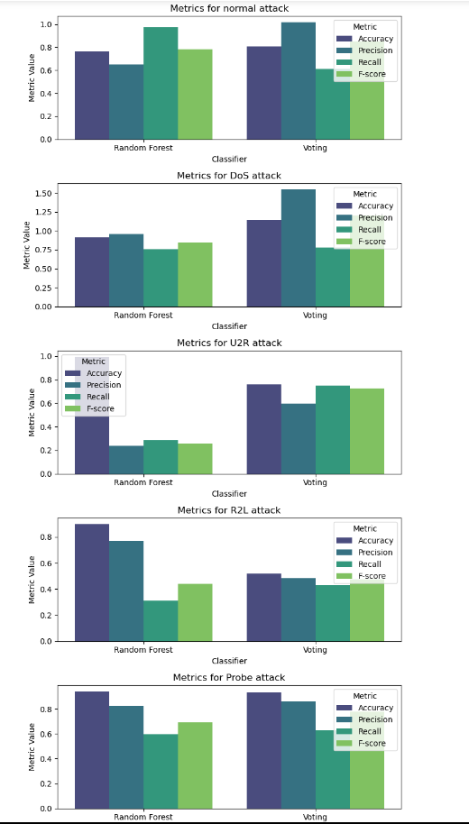
Experimental Result
Comparison of accuracy, precision, recall and
f-score of the all algorithms:
Random-Forest
Voting

Slide 43
6)Deployment

Slide 44

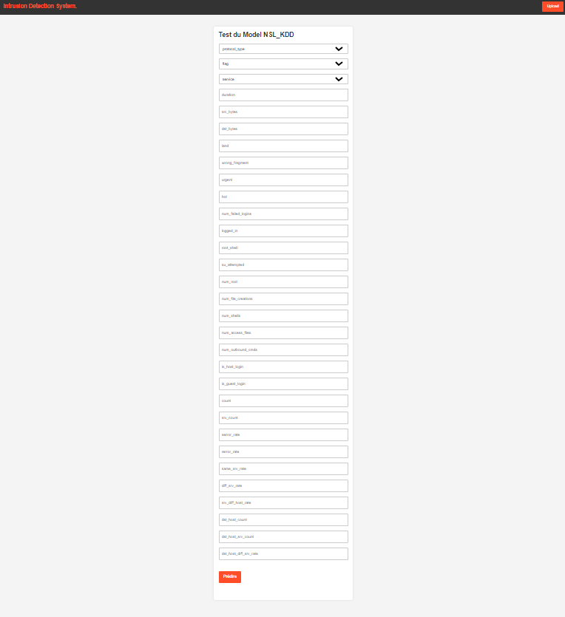
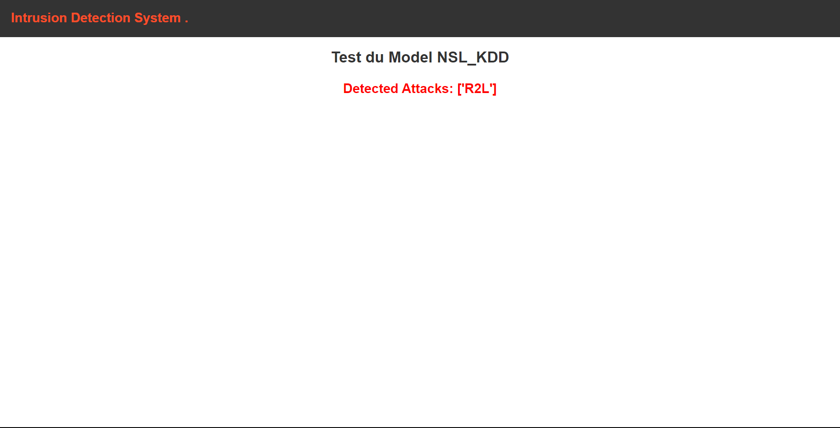
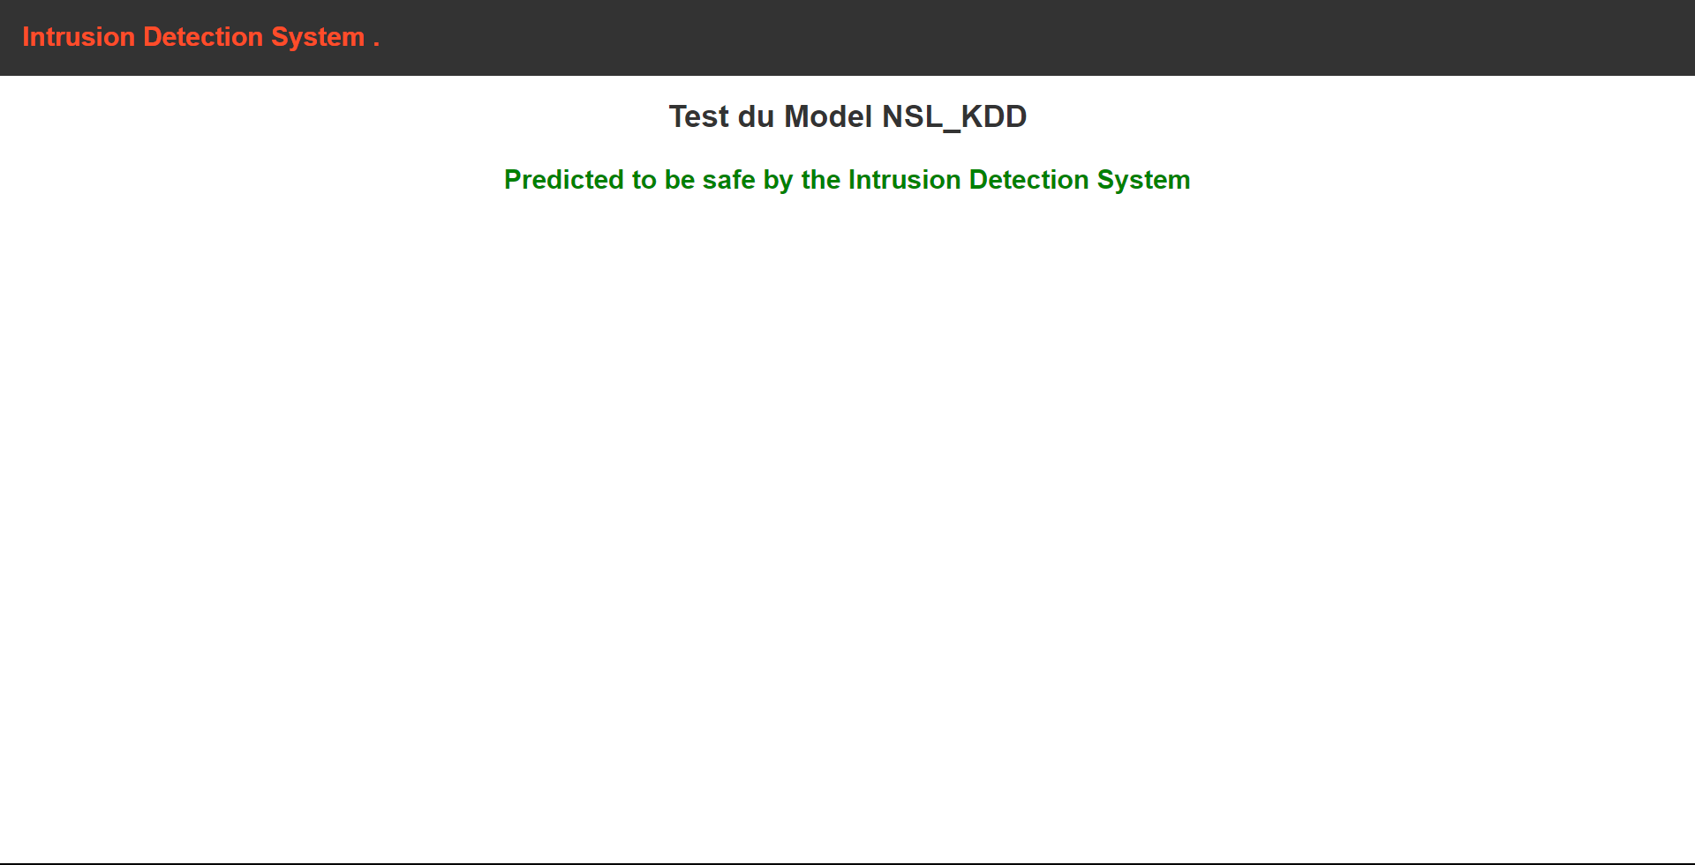
Tester

Slide 45

b)PAPER 2 :
unsupervised learning

Slide 46
3) DATA PREPARATION

Slide 47
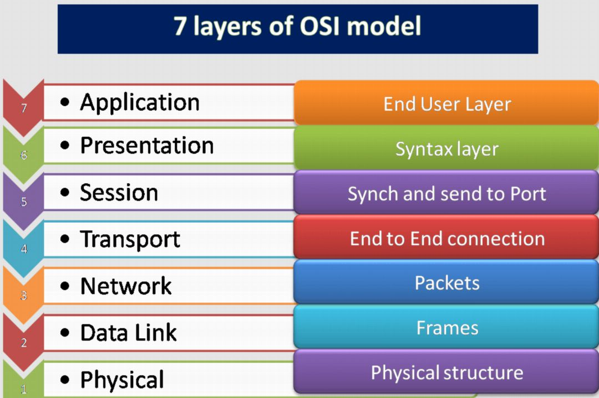
Dropping features that don’t belongs to the routing process :
Look at features designed for spotting anomalies, especially those related to router activity.
Ignore features beyond the third layer (network layer) since attacks often happens there.

Slide 48

Dropping
24 Features
protocol,_udp service, and flag
provided redundant information, leading us to decide to drop it as well.
hot,logged_in,num_failed_logins,....(16 features)
The features that
Are superior to the network layer
num_outbound_cmds
it exhibits no correlation with any other feature
difficulty level
does not provide significant information, so we need to drop it

Slide 49

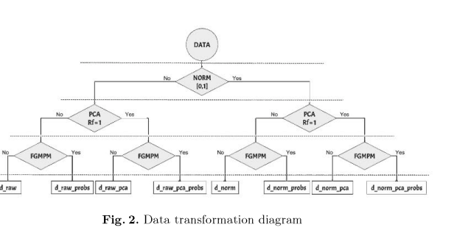
Data Transformation

Slide 50

01
d_raw:
d_norm
02
We apply normalizing to the original Dataset
The original NSL dataset without any transformation of the numerical values.
d_norm_probs
04
03
d_raw_probs:
We apply the FGPM to the normalized version of the
dataset.
We apply the FGMPM to the original NSL
d_norm_pca:
06
05
d_raw_pca
The uncorrelated version of the normalized dataset.
The uncorrelated version of the original NSL dataset
d_norm_pca_probs
08
07
d_raw_pca_probs:
The occurrence probabilities of the uncorrelated fea-
tures of the normalized dataset.
We apply the FGMPM to the uncorrelated version of the
original dataset

Slide 51
4)Modeling

Slide 52
For each DataSet we applied this models
Models
K-means
GMM (kde)
Probability Voting Scheme
SVM
BIRCH
MLP

Slide 53
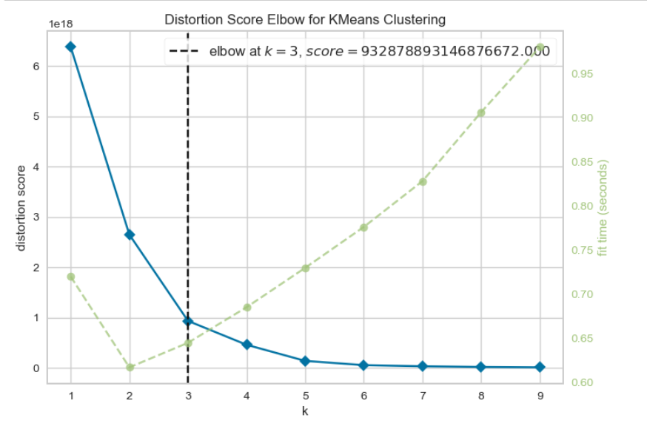
K-means
01
Elbow Visualizer
determining the optimal number of clusters using the Elbow Method
Based on the elbow graphe we can see that we need only 3 clusters in the train data as said also in the article

Slide 54

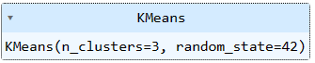
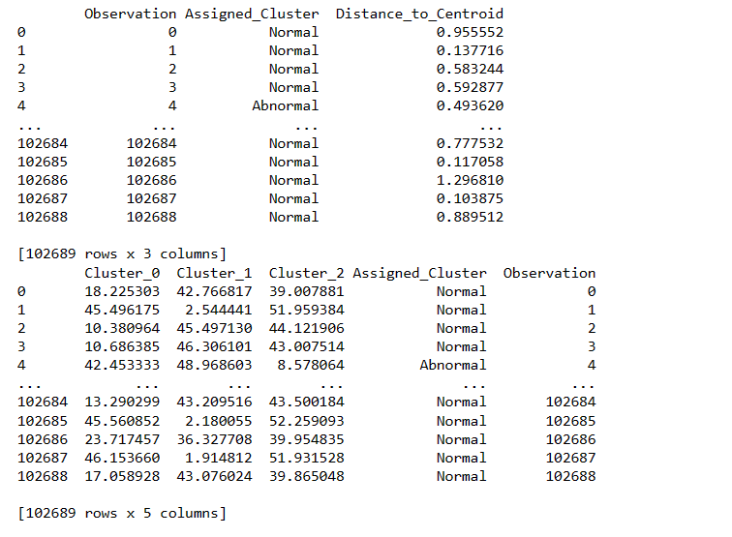
K-means
02
Creating a K Means Model
03
assigning labels to observations
(KM-D) for the dataset d_norm

Slide 55
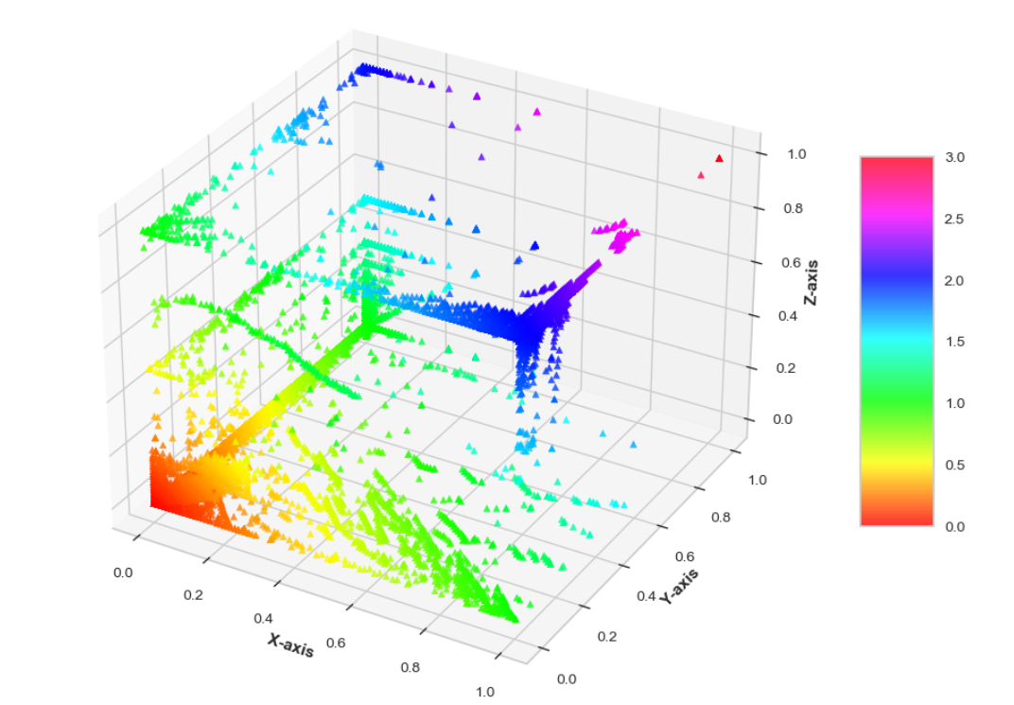
K-means
04
animated 3D scatter plot
animated 3D scatter plot using Matplotlib and visualizes the data from d_norm with respect to three specified columns: dst_host_serror_rate, dst_host_srv_count, and serror_rate

Slide 56
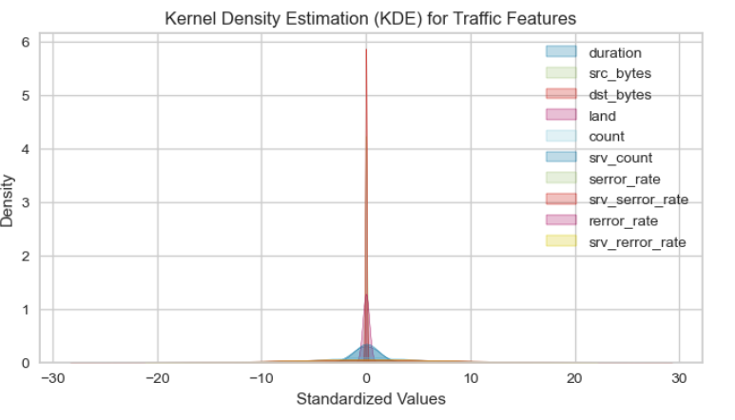
FGMPM
01
d_norm_probs:
We apply the FGPM to the normalized version of the dataset
-KDE provides insights into the distribution of values for each traffic feature in d_raw The shape of the KDE plot indicates the density of data points at different values of the features.

Slide 57
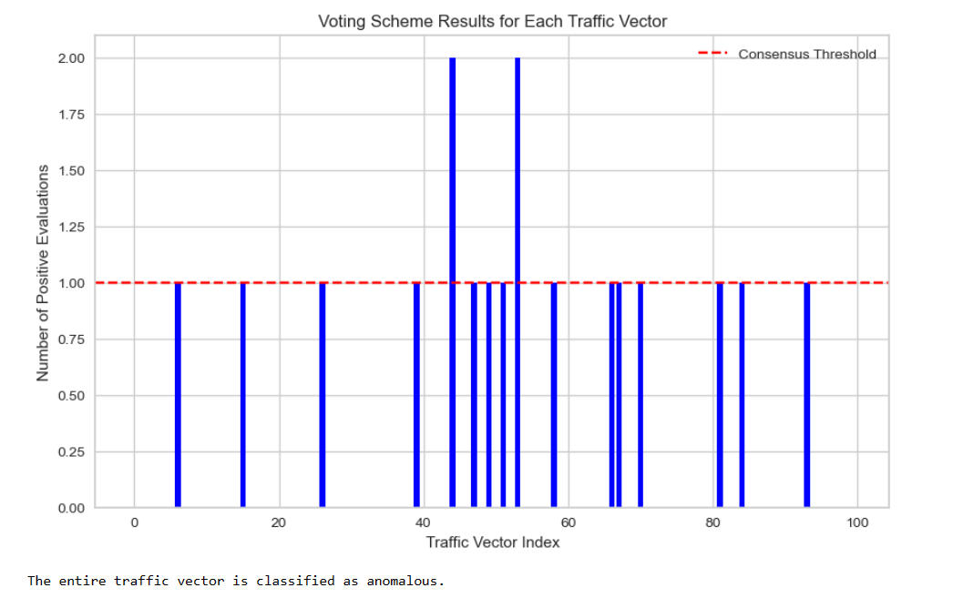
Probability Voting Scheme
01
Probability Voting Scheme for d_norm_probs:
We apply the FGPM to the normalized version of the dataset
-KDE provides insights into the distribution of values for each traffic feature in d_raw The shape of the KDE plot indicates the density of data points at different values of the features.

Slide 58
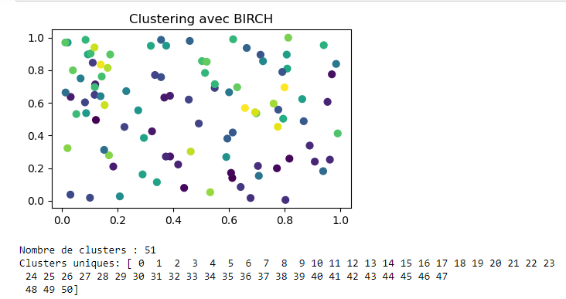
BIRCH (Balanced Iterative Reducing and Clustering using Hierarchies)
01
To operate efficiently with memory constraints.
BIRCH (Balanced Iterative Reducing and Clustering using Hierarchies) uses a structure called Clustering Feature (CF) to represent each cluster. A CF contains aggregated information such as the sum, sum of squares, and the number of elements in the cluster

Slide 59
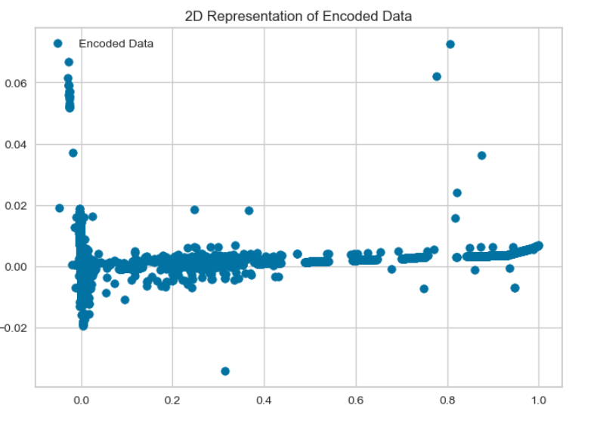
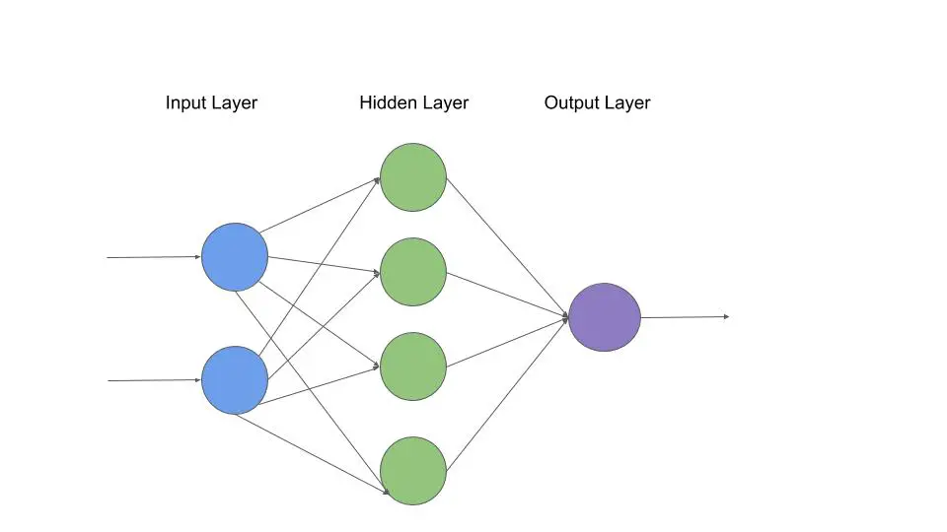
MLP (Multi-Layer Perceptron)
01
MLP on d_norm_pca
visualizing the encoded data in 2D using a scatter plot.

Slide 60
OUTPUT (2)
DoS (Denial of Service
R2L (Root to Local):
U2R (User to Root)
Probe

Slide 61
5)Evaluation

Slide 62
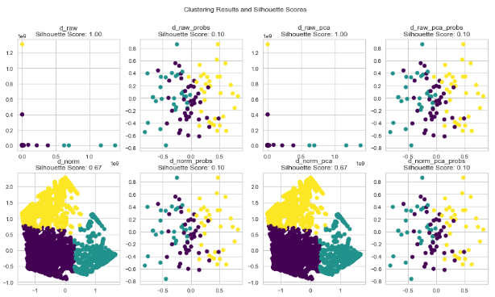

05
Evaluation
shows the result of the implementation of each
Algorithm on different datasets

Slide 63


“If you have any questions, feel free to ask ChatGPT.
Thank you."

